Slide 1
Intro to Practical development
Making things with raspberry Pi and Python!

Slide 2
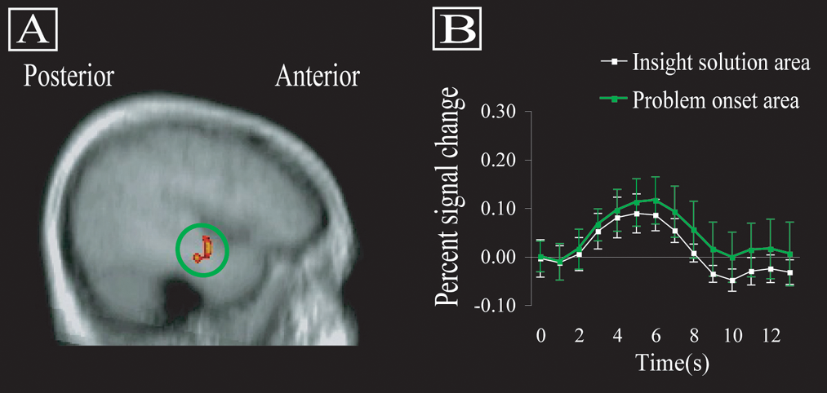
Practical Development

Slide 3




What *are* we doing?
Building
Developing
Testing
Making! Hacking! Developing!

Slide 4
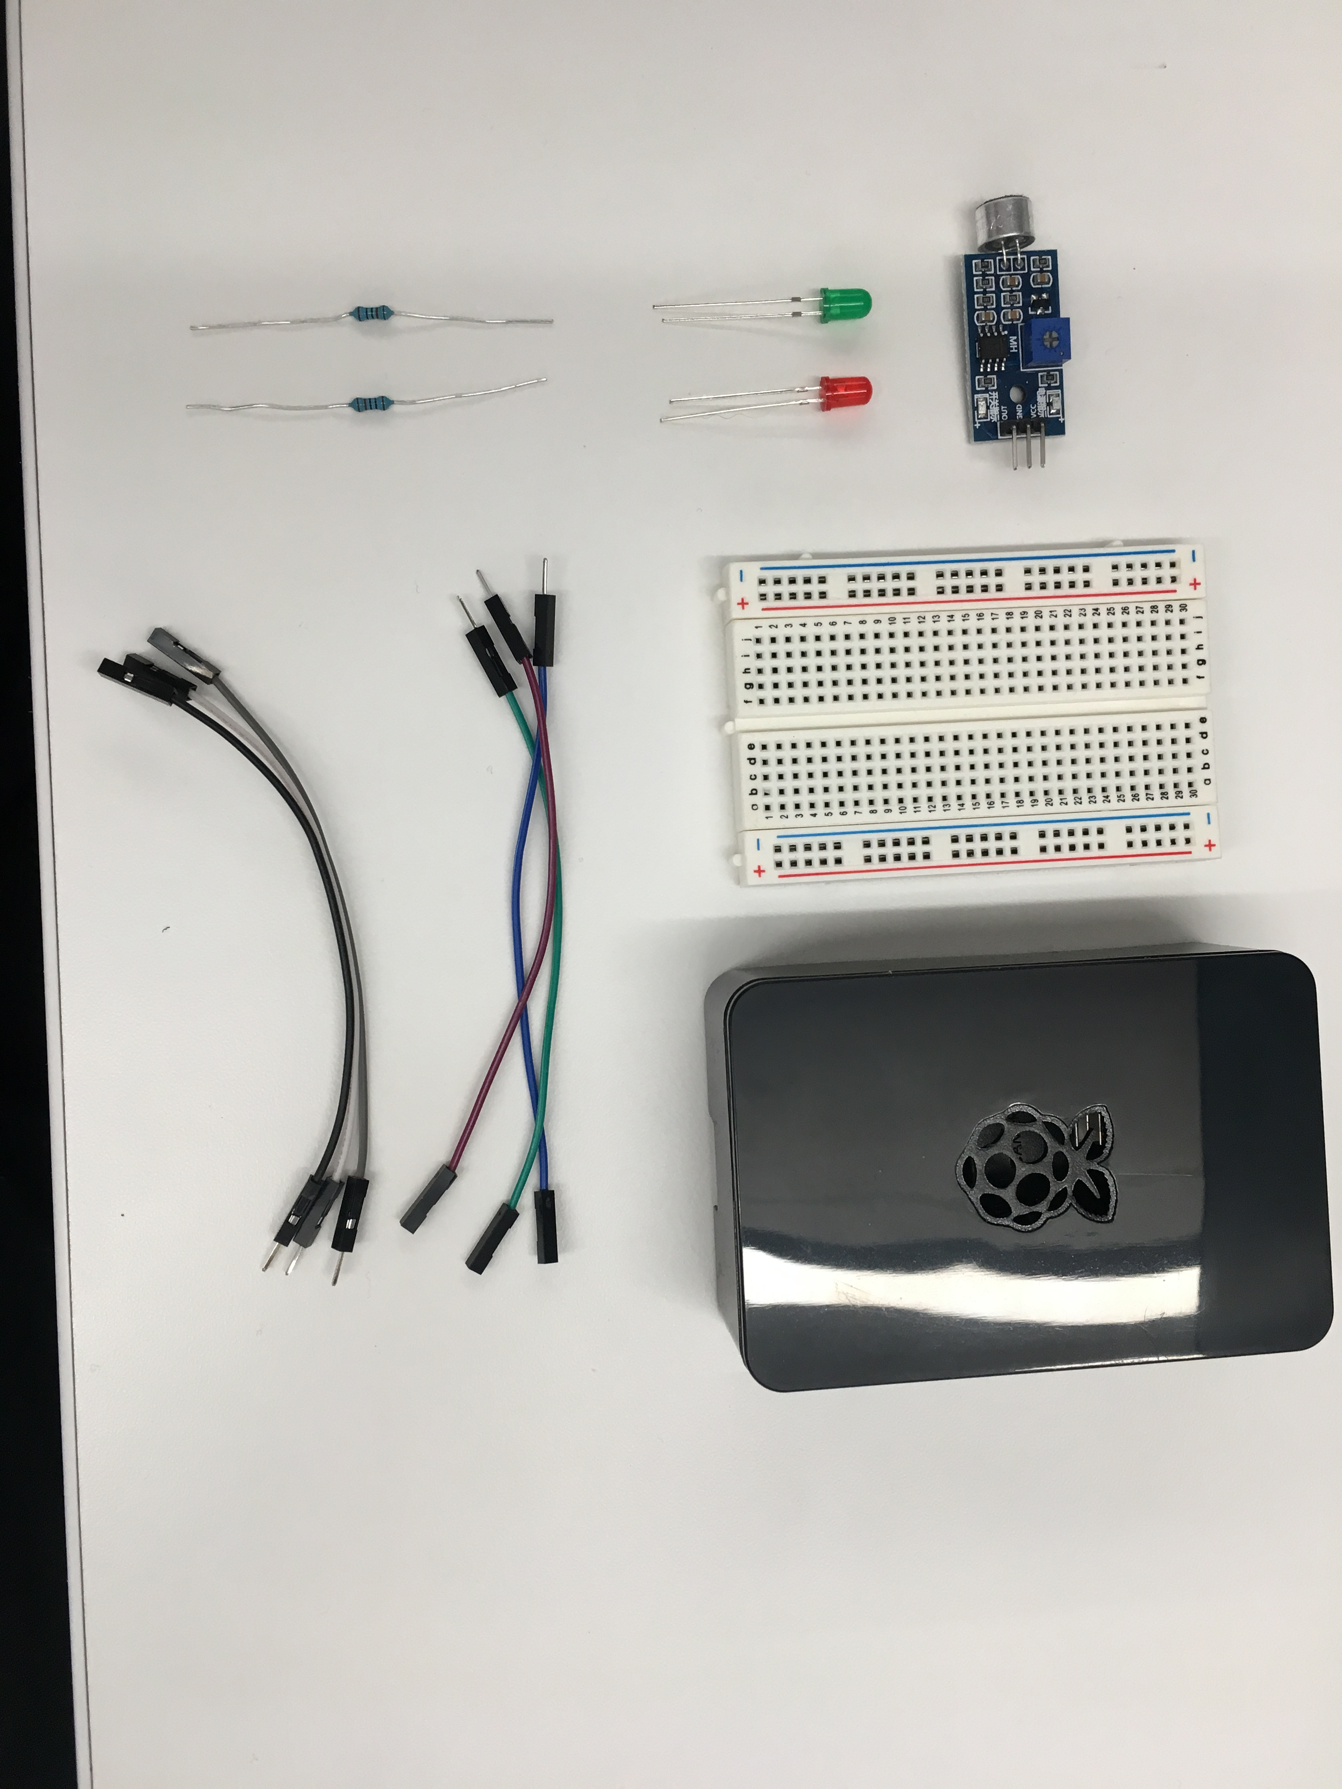
Hardware – AKA What’s in the box
Basic hardware required to build our project
Breadboard
Wires
Lights
Resistors
Sensor
Raspberry Pi 3

Slide 5
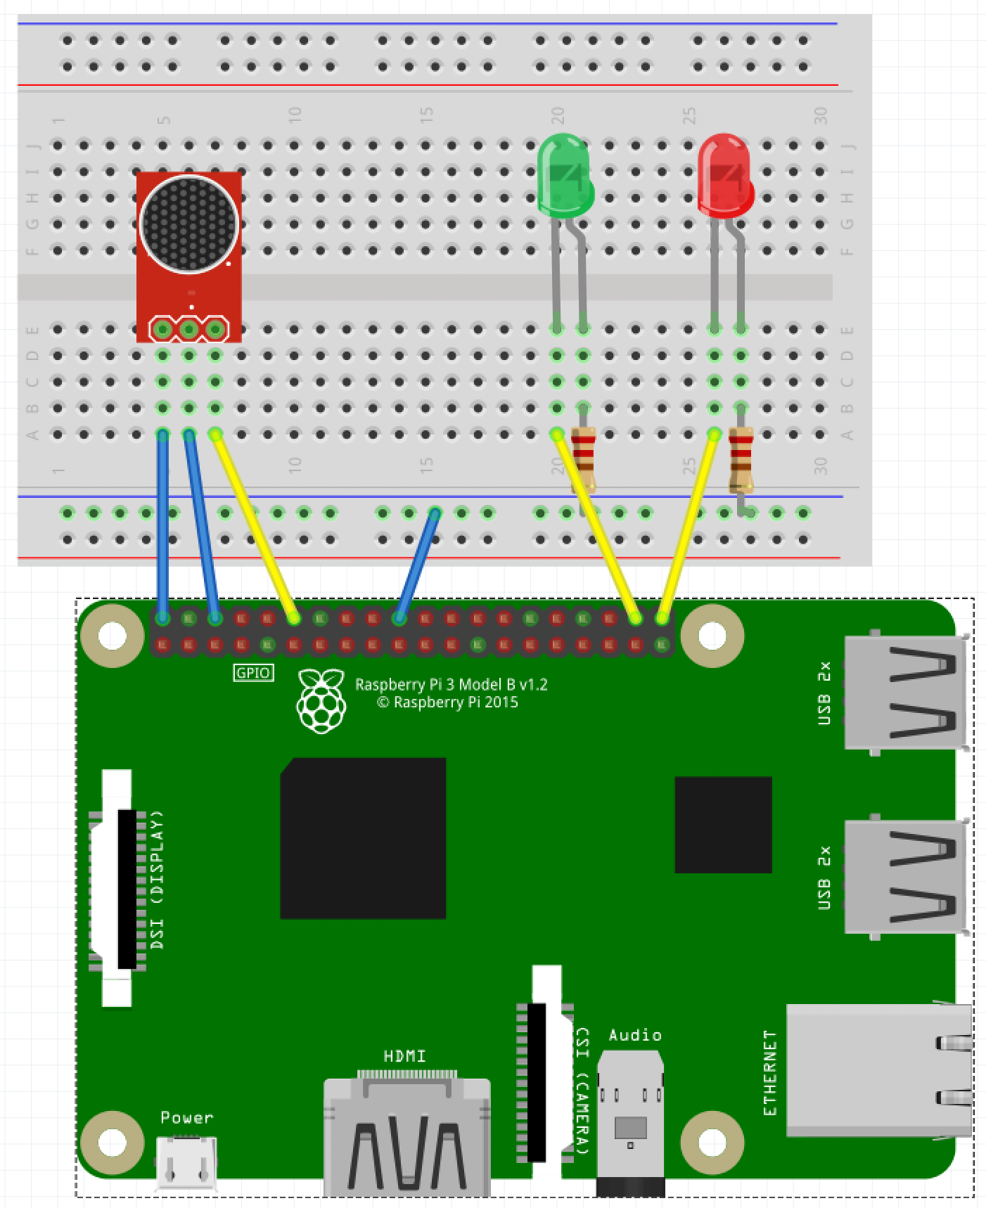
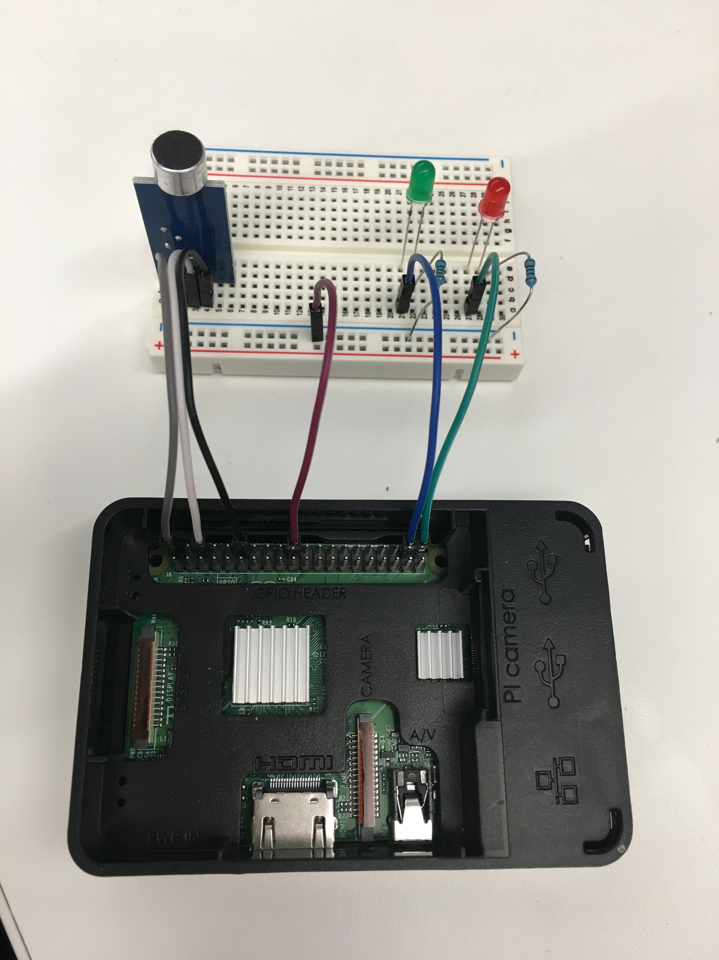
wiring
Circuit – the electrical version of “connect the dots”
Power flows from high to low
Too much power is bad!
We can “slow down” the flow

Slide 6
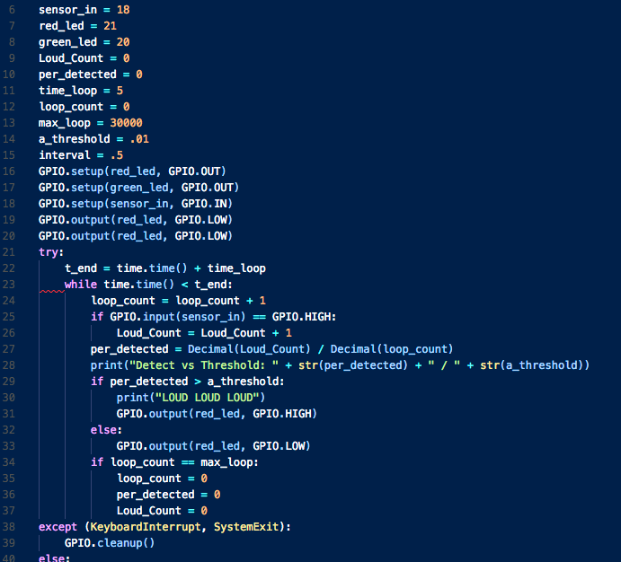
software
Variables
Functions
Inputs
Outputs

Slide 7

What’s next?

Slide 8
Some resources for you And a Favor for me
Official Resources:
Raspberypi.org
Python.org
Other Resources:
Github.com/ChrisHarrold
@charrold303
Youtube! Instructables! Amazon!
A Favor:
http://bit.ly/charrold

